Slide 1

Customer Retention Strategy Through Offer Effectiveness Analysis

Slide 2
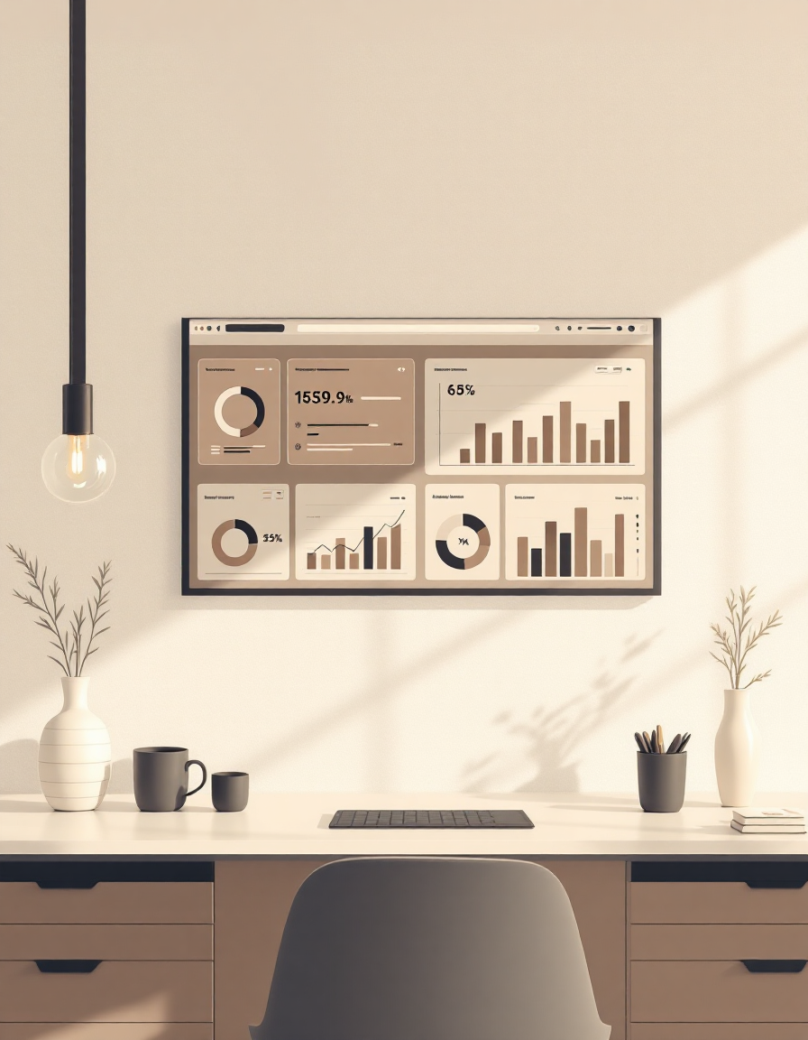
Understanding Customer Retention
Customer retention refers to a company’s ability to keep existing customers engaged, satisfied, and returning over time. It focuses on repeat purchase behaviour, loyalty levels, and the customer’s long-term relationship with the brand. High retention indicates that customers consistently find value in the product or service. Retaining customers is strategically important because it costs far less than acquiring new ones. Strong retention also improves profitability, as loyal customers tend to spend more and stay longer with the business. Companies that understand retention can design better experiences, reduce churn, and build a stable, predictable revenue base.

Slide 3

Project Abstract
This project analyses how different promotional offers influence customer behaviour, focusing on acceptance, redemption, and repeat purchase patterns. The dashboard evaluates offer types, communication channels, and before–after purchase behaviour to identify the drivers of higher retention. The insights highlight which strategies work effectively and where improvements are needed to strengthen overall customer engagement and retention. Overall, the analysis provides a data-driven foundation for refining offer design and improving retention outcomes.

Slide 4
Scope of the Study
1. Analyse the performance of different promotional
offers based on acceptance and redemption behaviour.
2. Examine customer purchase patterns by comparing
buying behaviour before and after the offers.
3. Evaluate category-wise and product-wise
contribution during offer periods.
4. Identify revenue fluctuations and potential
leakage areas related to offer campaigns.
5. Assess the overall effectiveness of offers in influencing customer retention and repeat purchases.

Slide 5

Study Objectives
01
Evaluate Offer Performance
Assess acceptance and redemption trends across different offer types to identify which promotions perform best.
02
Analyse Customer Purchase Behaviour
Compare purchase patterns before and after offers to understand changes in buying activity.
03
Measure Retention Outcomes
Examine how offers influence repeat purchases and short-term retention.
04
Identify Revenue Impact & Improvement Areas
Detect revenue fluctuations or leakage during offer periods and derive actionable insights to optimize future campaigns.

Slide 6
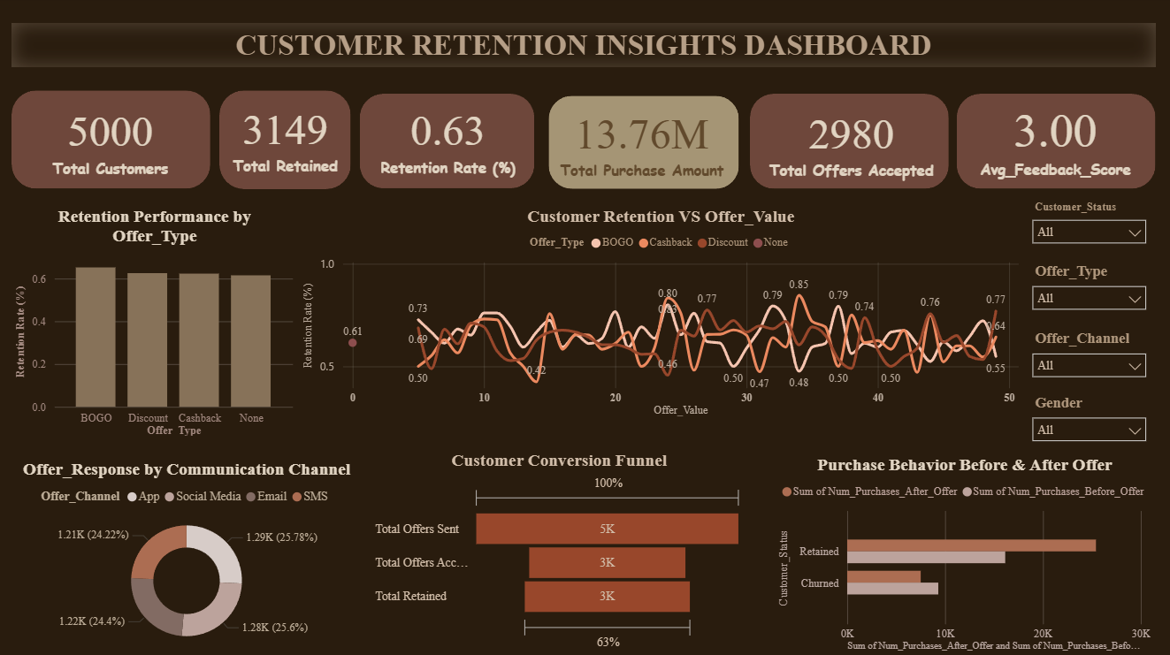
Dashboard Overview
The comprehensive analytics dashboard presents key metrics and visualizations that reveal customer retention patterns and offer effectiveness across multiple dimensions.

Slide 7









Key Findings and
Strategic Recommendations
BOGO Offers Get the Highest Response
Discount Offers Show
Low Response
Some Categories Perform
Better During Offers
Customers accept BOGO offers more than any other type.
Action: Use more BOGO-style offers to boost engagement.
Pure discount offers show weaker acceptance compared to value-based offers.
Action: Combine discounts with added value to improve performance.
Certain product categories show stronger purchase activity during offer periods.
Action: Prioritize offer campaigns on high-performing product categories.
Purchases Increase
After Offers
Monthly Response
Levels Vary
Informational Offers Get
Very Low Acceptance
Post-offer purchases are clearly higher than before.
Action: Send follow-up nudges to convert one-time responders into repeat buyers.
Offer acceptance changes from month to month.
Action: Launch campaigns during high activity months to maximize results.
Information-only messages have minimal customer interaction.
Action: Add incentives or benefits to improve engagement with informational messages.

Slide 8

Conclusion
This study shows that strategic offer design and targeted delivery strongly influence customer retention. Clear patterns emerge across offer types, channels, and customer behaviors, with BOGO and value-based offers driving the highest response.Implementing personalized, mobile-optimized campaigns based on these insights can significantly increase retention and customer lifetime value. The findings also provide a data-driven framework for continuously refining retention strategies to ensure stronger loyalty and measurable business impact.

Slide 9

Thank You
Presented by
Hiba

